Slide 1
Chapter 7 Sampling and Sampling Distributions
Simple Random Sampling
Point Estimation
Introduction to Sampling Distributions
Sampling Distribution of
Sampling Distribution of
Other Sampling Methods

Slide 2
7.3 Point Estimation
Point estimator or
Sample statistics
Population parameters
Values of point estimator= point estimates
Notes:
Values of point estimator= point estimates
Population parameters

Slide 3
Sampling Error
The absolute difference between an unbiased point estimate and the corresponding population parameter is called the sampling error.
Sampling error is the result of using a subset of the population (the sample), and not the entire population to develop estimates.
The sampling errors are:
for sample mean
|s - σ | for sample standard deviation
for sample proportion

Slide 4
7.5 Sampling Distribution of
The sampling distribution of is the probability distribution of all possible values of the sample
mean .
Expected Value of
E( ) = μ
where:
μ = the population mean

Slide 5
Sampling Distribution of (cont.)
4 6 8
u = 5
2,4 =3
2,6 = 4
2,8 =5
4,6 = 5
4,8 =6
6,8 =7
Notes:
2,4 2,6 2,8 4,6 4,8 6,8

Slide 6
Sampling Distribution of (cont.)
Standard Deviation of
Finite Population Infinite Population
A finite population is treated as being infinite if n/N < .05.
is the finite correction factor.
is referred to as the standard error of the mean.

Slide 7
Sampling Distribution of (cont.)
If we use a large (n > 30) simple random sample, the central limit theorem enables us to conclude that the sampling distribution of can be approximated by a normal probability distribution.
When the simple random sample is small (n < 30), the sampling distribution of can be considered normal only if we assume the population has a normal probability distribution.

Slide 8
7-6 Sampling Distribution of
The sampling distribution of is the probability distribution of all possible values of the sample proportion .
Expected Value of
where:
p = the population proportion

Slide 9
Sampling Distribution of (cont.)
p
Notes:
2,4 2,6 2,8 4,6 4,8 6,8

Slide 10
Sampling Distribution of (cont.)
Standard Deviation of ( Standard Error of )
Finite Population Infinite Population
A finite population is treated as being infinite if n/N < .05.
is the finite correction factor.
is referred to as the standard error of the proportion.

Slide 11
Practical Value of the Sampling Distribution of
The sampling distribution of can be used to provide probability information about the size of sampling error .
The sampling distribution of can be approximate by a normal distribution whenever the sample size is large.
Rule of Thumb:
np > 5
n(1 - p) > 5

Slide 12
Chapter 8 Interval Estimation
Interval Estimation of a Population Mean:
Large-Sample Case
Interval Estimation of a Population Mean:
Small-Sample Case
Determining the Sample Size
Interval Estimation of a Population Proportion

Slide 13
Sampling Error =
u

Slide 14
Interval Estimate of a Population Mean:
With σ Known
where: is the sample mean
1 -α is the confidence coefficient
z_{α/2} is the z value providing an area of
α/2 in the upper tail of the standard
normal probability distribution
σ is the population standard deviation
n is the sample size

Slide 15
Interval Estimation of a Population Mean: with σ Unknown
Interval Estimate
where 1 -α = the confidence coefficient
t_{α/2} = the t value providing an area of α/2 in the upper tail of a t distribution
with n - 1 degrees of freedom
s = the sample standard deviation

Slide 16
t Distribution
The t distribution is a family of similar probability distributions.
A specific t distribution depends on a parameter known as the degrees of freedom.
As the number of degrees of freedom increases, the difference between the t distribution and the standard normal probability distribution becomes smaller and smaller.
A t distribution with more degrees of freedom has less dispersion.
The mean of the t distribution is zero.

Slide 17
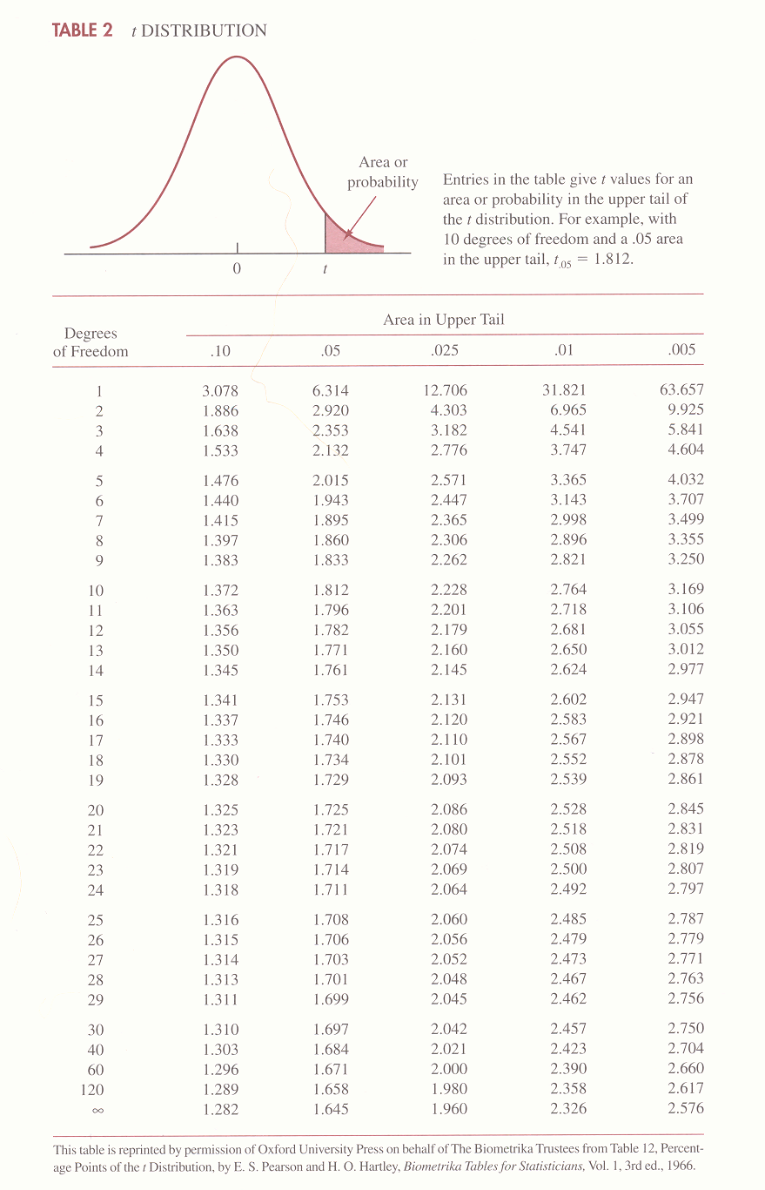

Slide 18
t Distribution (cont.)
a. Find P(t>2.228) if n=11
df=10
=0.025
b. Find P(t<-2.228) if n=11
=0.25
2.228
-2.228
Notes:
-2.228

Slide 19
t Distribution (cont.)
.025
c. Find P(t<2.228) if n=11
=1-.025=0.975
d. Find the upper 5% and the lower 5% points of the t-distribution with 15 d.f.
=1.753
2.228
.05
.05
-1.753
1.753
Notes:
-1.753

Slide 20
8.3 Sample Size for an Interval Estimate of a Population Mean
Let E = the maximum sampling error mentioned in the precision statement.
E is the amount added to and subtracted from the point estimate to obtain an interval estimate.
E is often referred to as the margin of error.
We have
Solving for n we have

Slide 21
8.4 Interval Estimation of a Population Proportion
p
Can use normal distribution iff
Notes:
Can use normal distribution iff

Slide 22
8.4 Interval Estimation of a Population Proportion (cont.)
Interval Estimate
where: 1 -α is the confidence coefficient
z_{α/2} is the z value providing an area of
α/2 in the upper tail of the standard normal probability distribution
is the sample proportion

Slide 23
Sample Size for an Interval Estimate of a Population Proportion
Let E = the maximum sampling error mentioned in the precision statement.
We have
Solving for n we have

Slide 24
Chapter 9 Hypothesis Testing
Developing Null and Alternative Hypotheses
Type I and Type II Errors
One-Tailed Tests about a Population Mean: Large-Sample Case
Two-Tailed Tests about a Population Mean: Large-Sample Case
Tests about a Population Mean: Small-Sample Case
Tests about a Population Proportion

Slide 25
9.1 Developing Null and Alternative Hypotheses
Hypothesis testing can be used to determine whether a statement about the value of a population parameter should or should not be rejected.
The null hypothesis, denoted by H₀ , is a tentative assumption about a population parameter.
The alternative hypothesis, denoted by H_{a}, is the opposite of what is stated in the null hypothesis.
Hypothesis testing is similar to a criminal trial. The hypotheses are:
H₀: The defendant is innocent
H_{a}: The defendant is guilty

Slide 26
Developing Null and Alternative Hypotheses (cont.)
Testing in Decision-Making Situations
A decision maker might have to choose between two courses of action, one associated with the null hypothesis and another associated with the alternative hypothesis.
Example: Accepting a shipment of goods from a supplier or returning the shipment of goods to the supplier.
H₀: p < .01 _{accept the shipment}
H_{a}: p > .01 _{reject the shipment}

Slide 27
A Summary of Forms for Null and Alternative Hypotheses about a Population Mean
The equality part of the hypotheses always appears in the null hypothesis.
In general, a hypothesis test about the value of a population mean μ must take one of the following three forms (where μ₀ is the hypothesized value of the population mean).
H₀: μ > μ₀ H₀: μ < μ₀ H₀: μ = μ₀
H_{a}: μ < μ₀ H_{a}: μ > μ₀ H_{a}: μ ≠ μ₀

Slide 28
Example
a. The mean family income in a certain county is no more than $15000/year. A researcher believes that this assumption is not true. Develop H₀ and H_{a}
H₀: μ < 15,000
H_{a}: μ > 15,000
b. The mean family income in a certain county is at least $15000/year. A researcher believes that this assumption is not true. Develop H₀ and H_{a}
H₀: μ > 15,000
H_{a}: μ < 15,000
c. The mean family income in a certain county is $15000/year. A researcher believes that this assumption is not true. Develop H₀ and H_{a}
H₀: μ = 15,000
H_{a}: μ ≠ 15,000

Slide 29
9.2 Type I and Type II Errors
Population Condition
H₀ True H₀ False
Conclusion
Accept H₀ Correct Type II
Conclusion Error
Reject H₀ Type I Correct
Εrror Conclusion

Slide 30
Type I and Type II Errors (cont.)
Since hypothesis tests are based on sample data, we must allow for the possibility of errors.
A Type I error is rejecting H₀ when it is true.
α = Probability of type I error
= P (rejecting H₀ \ H₀ is true)
A Type II error is accepting H₀ when it is false.
β= Probability of type II error
= P (accepting H₀ \ H₀ is false)

Slide 31
Type I and Type II Errors (cont.)
The person conducting the hypothesis test specifies the maximum allowable probability of making a
Type I error, denoted by α and called the level of significance.
Statistically significant
Generally, we cannot control for the probability of making a Type II error, denoted by β.
Statistician avoids the risk of making a Type II error by using “do not reject H₀” and not “accept H₀”.
Note: It is not correct to say “accept H₀‘’. Instead for now on we say “do not reject H₀”.

Slide 32
9.3-9.4 One-Tailed and Two-Tailed Tests
Left-Tailed Test  : Rejection region is on the left tail of the distribution.
H₀: μ > 15,000
H_{a}: μ < 15,000
-z_{α}
-t_{α}
Right-Tailed Test  : Rejection region is on the right tail of the distribution.
H₀: μ < 15,000
H_{a}: μ > 15,000
z_{α}
t_{α}

Slide 33
9.3-9.4 One-Tailed and Two-Tailed Tests (cont.)
Two-Tailed Test  : Rejection region is on the both tails of the distribution.
H₀: μ = 15,000
H_{a}: μ ≠ 15,000
-z_{α/2} z_{α/2}
-t_{α/2} t_{α/2}

Slide 34
The Use of p-Values
The p-value is the probability of obtaining a sample result that is at least as unlikely as what is observed.
The p-value can be used to make the decision in a hypothesis test by noting that:
if the p-value is less than the level of significance α, the value of the test statistic is in the rejection region.
if the p-value is greater than or equal to α, the value of the test statistic is not in the rejection region.
Reject H₀ if the p-value < α.

Slide 35
One &Two-Tailed Tests about a Population Mean:
Hypotheses
H₀: μ > μ₀ H₀: μ < μ₀ H₀: μ = μ₀
H_{a}: μ < μ₀ H_{a}: μ > μ₀ H_{a}: μ ≠μ₀
Test Statistic σ Known
Rejection Rule (1)
Reject H₀ if z₀ < -z_{α} Reject H₀ if z₀ > z_{α} Reject H₀ if z₀ < - z_{α/2} or
if z₀ > z_{α/2}
-z_{α} z_{α} - z_{α/2} z_{α/2}

Slide 36
One &Two-Tailed Tests about a Population Mean
Rejection Rule (2) Reject if P.V<α
P.V= P ( Z< Z₀) P.V = P ( Z > Z₀) P.V= 2 P( Z< Z₀) or
P.V= 2 P (Z > Z₀)
-z₀ z₀ - z₀ z₀

Slide 37
Confidence Interval Approach to a Two-Tailed Test about a Population Mean
Select a simple random sample from the population and use the value of the sample mean to develop the confidence interval for the population mean μ.
H₀: μ = μ₀
H_{a}: μ ≠μ₀
If the confidence interval contains the hypothesized value μ₀, do not reject H₀. Otherwise, reject H₀.

Slide 38
9.5 Tests About a Population Mean
Hypotheses
H₀: μ > μ₀ H₀: μ < μ₀ H₀:μ = μ₀
H_{a}: μ < μ₀ H_{a}: μ >μ₀ H_{a}:μ ≠ μ₀
Test Statistic:
σ Unknown
Rejection Rule (1):
Reject H₀ if t₀< -t_{α} Reject H₀ if t₀ >t_{α} Reject H₀ if t₀< - t_{α/2} or
if t₀ > t_{α/2}
- t_{α} tα -t _{α/2} t _{α/2}
Notes:
τ_{α} - t _{α/2}

Slide 39
Tests About a Population Mean
Rejection Rule (2) Reject if P.V<α
P.V= P ( t < t₀) P.V = P ( t > t₀) P.V= 2 P( t < t₀) or
P.V= 2 P (t > t₀)
- t₀ t ₀ ₋t ₀ t ₀

Slide 40
9.6 Tests About a Population Proportion
Hypotheses
H₀: p > p₀ H₀: p < p₀ H₀: p = p₀
H_{a}: p < p₀ H_{a}: p > p₀ H_{a}: p ≠ p₀
Test Statistic:
Rejection Rule (1)
Reject H₀ if z₀ < -z_{α} Reject H₀ if z₀ > z_{α} Reject H₀ if z₀ < - z_{α/2} or
if z₀ > z_{α/2}
-z_{α} z_{α} - z_{α/2} z_{α/2}

Slide 41
Tests About a Population Proportion (cont.)
Rejection Rule (2) Reject if P.V<α
P.V= P ( Z< Z₀) P.V = P ( Z > Z₀) P.V= 2 P( Z< Z₀) or
P.V= 2 P (Z > Z₀)
-z₀ z₀ - z₀ z₀

Slide 42
Chapter 10 Comparisons Involving Means
Inferences About the Difference Between
Two Population Means: σ ₁ and σ ₂ Known
Inferences About the Difference Between
Two Population Means: σ ₁ and σ ₂ Unknown
Inferences About the Difference Between
Two Population Means: Matched Samples

Slide 43
10.1 Inferences About the Difference Between Two Population Means: σ ₁ and σ ₂ Known
Interval Estimation of μ ₁ – μ ₂
Hypothesis Tests About μ ₁ – μ ₂

Slide 44
Estimating the Difference Between Two Population Means
Let μ₁ equal the mean of population 1 and μ₂ equal
the mean of population 2.
The difference between the two population means is
μ₁ - μ₂.
To estimate μ₁ - μ₂, we will select a simple random
sample of size n₁ from population 1 and a simple
random sample of size n₂ from population 2.
Let equal the mean of sample 1 and equal the
mean of sample 2.
The point estimator of the difference between the
means of the populations 1 and 2 is .

Slide 45
Sampling Distribution of
Expected Value
Standard Deviation
where: σ₁ = standard deviation of population 1
σ₂ = standard deviation of population 2
n₁ = sample size from population 1
n₂ = sample size from population 2

Slide 46
Interval Estimation of μ₁ - μ₂: σ ₁ and σ ₂ Known
Interval Estimate
where:
1 - α is the confidence coefficient

Slide 47
Chapter 10 Comparisons Involving Means
Estimation of the Difference Between the Means of
Two Populations: Independent Samples
Hypothesis Tests about the Difference between the
Means of Two Populations: Independent Samples
Inferences about the Difference between the Means
of Two Populations: Matched Samples
Inferences about the Difference between the
Proportions of Two Populations:

Slide 48
Hypothesis Tests About μ ₁ − μ ₂: σ ₁ and σ ₂ Known
Hypotheses
Left-tailed
Right-tailed
Two-tailed

Slide 49
Hypothesis Tests About μ ₁ − μ ₂: σ ₁ and σ ₂ Known
Hypotheses
Left-tailed
Right-tailed
Two-tailed
Test Statistic

Slide 50
Hypothesis Tests About the Difference between the Means of Two Populations:
Rejection Rule (1)
Reject H₀ if z₀ < -z_{α} Reject H₀ if z₀ > z_{α} Reject H₀ if z₀ < - z_{α/2}
or if z₀> z_{α/2}
-z_{α} z_{α} - z_{α/2} z_{α/2}

Slide 51
Hypothesis Tests About the Difference between the Means of Two Populations:
Rejection Rule (2) p–value < a
P.V= P ( Z< Z₀) P.V = P ( Z > Z₀) P.V= 2 P( Z< Z₀) or
P.V= 2 P (Z > Z₀)
-z₀ z₀ - z₀ z₀

Slide 52
Interval Estimation of μ₁ - μ₂: σ ₁ and σ ₂ Unknown
When σ ₁ and σ ₂ are unknown, we will:
use the sample standard deviations s₁ and s₂
as estimates of σ ₁ and σ ₂ , and
replace z_{α/2} with t_{α/2}.

Slide 53
Interval Estimation of μ₁ - μ₂: σ ₁ and σ ₂ Unknown
Interval Estimate
Where the degrees of freedom for t_{α/2} are:

Slide 54
Hypothesis Tests About μ ₁ − μ ₂: σ ₁ and σ ₂ Unknown
Hypotheses
Left-tailed
Right-tailed
Two-tailed

Slide 55
Hypothesis Tests About μ ₁ − μ ₂: σ ₁ and σ ₂ Unknown
Hypotheses
Left-tailed
Right-tailed
Two-tailed
Test Statistic

Slide 56
Hypothesis Tests About the Difference between the Means of Two Populations:
Rejection Rule (1):
Reject H₀ if t₀< -t_{α} Reject H₀ if t₀ >t_{α} Reject H₀ if t₀< - t_{α/2} or
if t₀ > t_{α/2}
- t_{á} t_{á -}t _{á/2} t _{á/2}
Notes:
τ_{á} - t _{á/2}

Slide 57
Hypothesis Tests About the Difference between the Means of Two Populations:
Rejection Rule (2) p–value < a
P.V= P ( t < t₀) P.V = P ( t > t₀) P.V= 2 P( t < t₀) or
P.V= 2 P (t > t₀)
- t₀ t ₀ ₋t ₀ t ₀

Slide 58
10.3 Inferences About the Difference Between Two Population Means: Matched Samples
With a matched-sample design each sampled item
provides a pair of data values.
This design often leads to a smaller sampling error
than the independent-sample design because
variation between sampled items is eliminated as a
source of sampling error.

Slide 59
Inferences About the Difference Between the Proportions of Two Populations
Sampling Distribution of
Interval Estimation of p₁ - p₂
Hypothesis Tests about p₁ - p₂

Slide 60
Sampling Distribution of
Expected Value
Standard Deviation
Distribution Form
If the sample sizes are large (n₁p₁, n₁(1 - p₁), n₂p₂,
and n₂(1 - p₂) are all greater than or equal to 5), the
sampling distribution of can be approximated
by a normal probability distribution.

Slide 61
Interval Estimation of p₁ - p₂
Interval Estimate
Point Estimator of

Slide 62
Hypothesis Tests about p₁ - p₂
Hypotheses
H₀: P₁ - P₂ < 0 H₀: P₁ - P₂ > 0 H₀: P₁ - P₂ = 0
H_{a}: P₁ - P₂ > 0 H_{a}: P₁ - P₂ < 0 H_{a}: P₁ - P₂ ≠ 0
Test statistic
Point Estimator of where p₁ = p₂
where:

